Slide 1

Air pollution in india
Project-4
Damuluri Manikanta

Slide 2
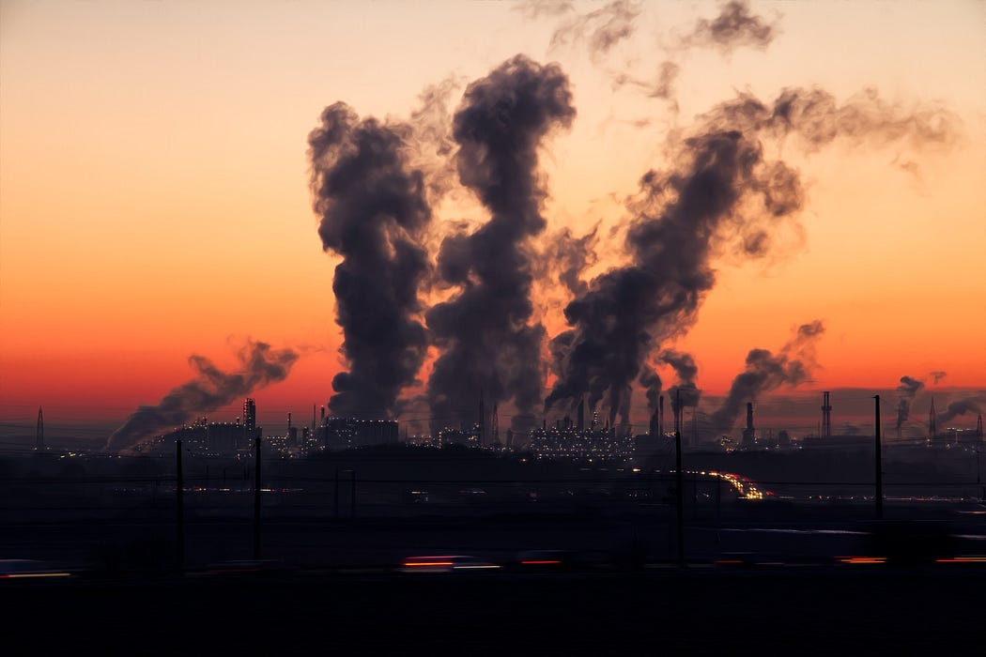
Introduction
Today air pollution has been one of the significant problems to deal with for any nation. In South Asia, it is ranked as the sixth most dangerous killer. One does not realize the harmful effects of a problem if he/she has not experienced it in the first place. Take Delhi, for instance, we all have experienced what it feels like inhaling in the ‘deadly’ smog that remained for about a week, after Diwali. Citizens were advised not to leave their homes and were asked to wear masks whenever going outside. Looking outside the window made me feel like I was living in a gas chamber. Low visibility, a high number of deaths, etc. were the effects of pollution.

Slide 3
reports that air pollution was responsible for 1.1 million deaths in India in 2015.

Slide 4
How bad is India's air pollution?
In recent years, India has been experiencing some of the worst air pollution in the world. In 2020, India was ranked as the world's most polluted country by the IQAir AirVisual report. The country's air pollution problem is a serious public health issue and has been linked to numerous health problems, including respiratory and cardiovascular diseases.

Slide 5

What are the sources of India's polluted air?
There are many sources of air pollution in India, including vehicle emissions, industrial pollution, dust and construction, and burning of crop residues and waste. In addition, natural factors such as dust storms and wildfires can also contribute to air pollution.

Slide 6

What effects does this poor air quality have on health?
Poor air quality in India has been linked to a range of health problems, including respiratory diseases such as asthma and bronchitis, cardiovascular diseases such as heart attacks and strokes, and even premature death. Children, pregnant women, and the elderly are particularly vulnerable to the effects of air pollution.

Slide 7
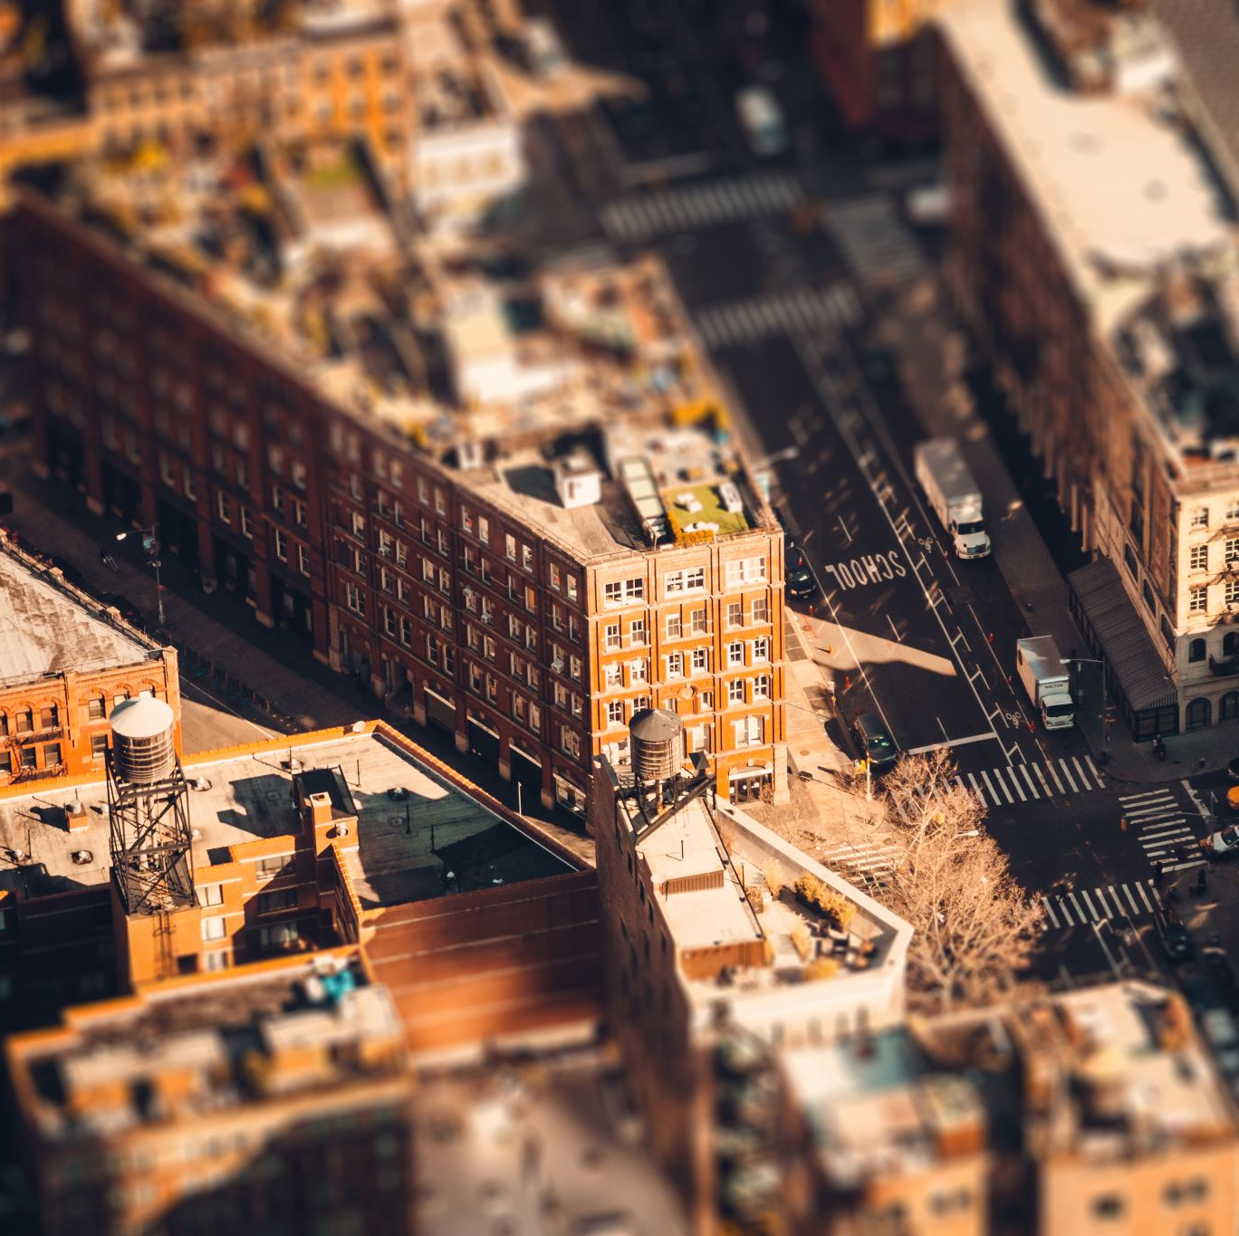
Where are the cities that have improved in stats?
Indian cities have seen improvements in their air quality statistics. There have been some efforts to improve air quality in Indian cities in recent years, and some cities have shown improvement in their air quality statistics. For example, the city of Delhi has seen a significant reduction in particulate matter concentrations in the air in recent years. Other cities, such as Mumbai and Kolkata, have also seen improvements in their air quality, although they still face significant air pollution challenges.

Slide 8
Observations
We see that the majorly affected states in India by air pollution belong to the northern region.
States like Delhi, Punjab, Uttar Pradesh, Haryana are heavily polluted and require immediate action.
We also saw that even if a state had a high level of pollutants, there were some regions in the states that were not polluted.
The states with high rspm concentrations also have high spm concentrations.
From the heatmap, we conclude that some states were heavily polluted in the early stages(1987 to 2015) but, later, were taken care of.
The reason for the decrease could be awareness in citizens and government policies.

Slide 9

Conclusion
this was my analysis of my country, which is slowly turning to a gas chamber. Not only India but other countries are also suffering from air pollution.
We must find a cure to this significant problem as it is killing our nation slowly.

Slide 10

Thank you

